Slide 1



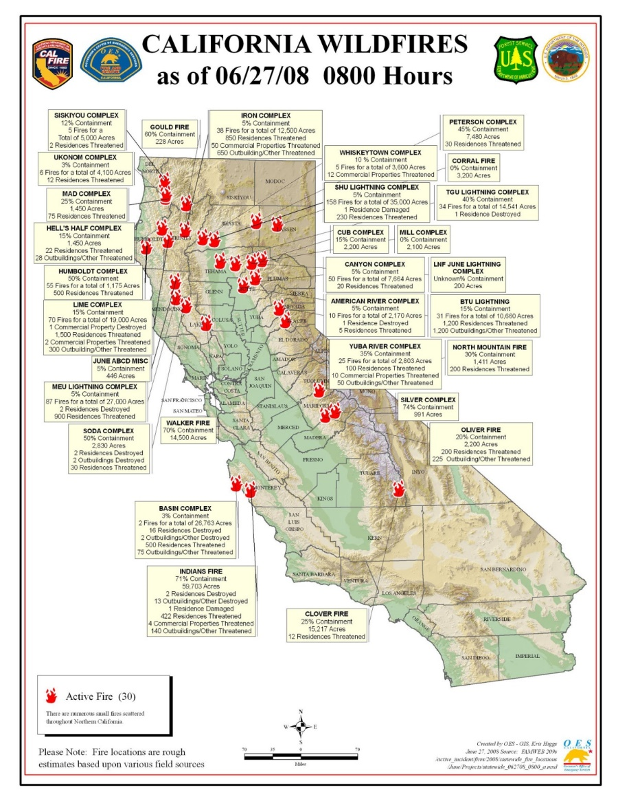
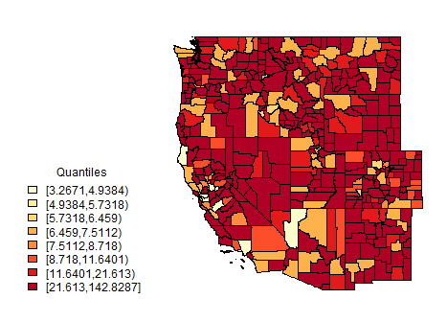
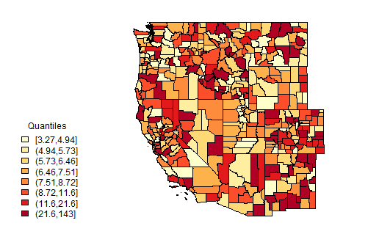
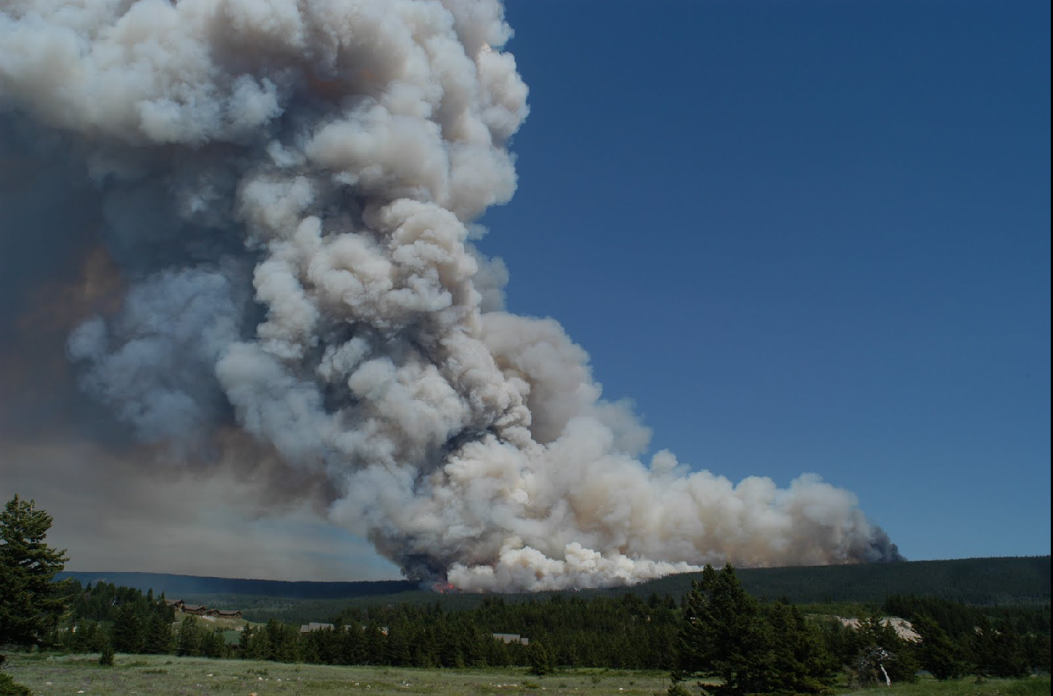
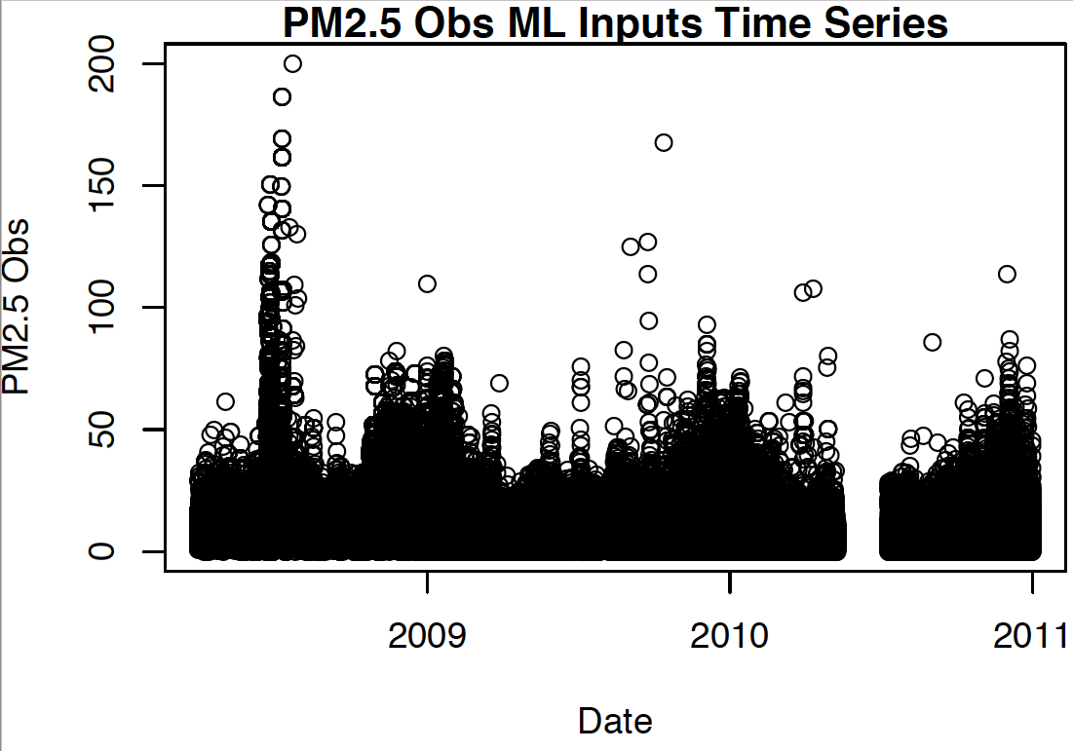
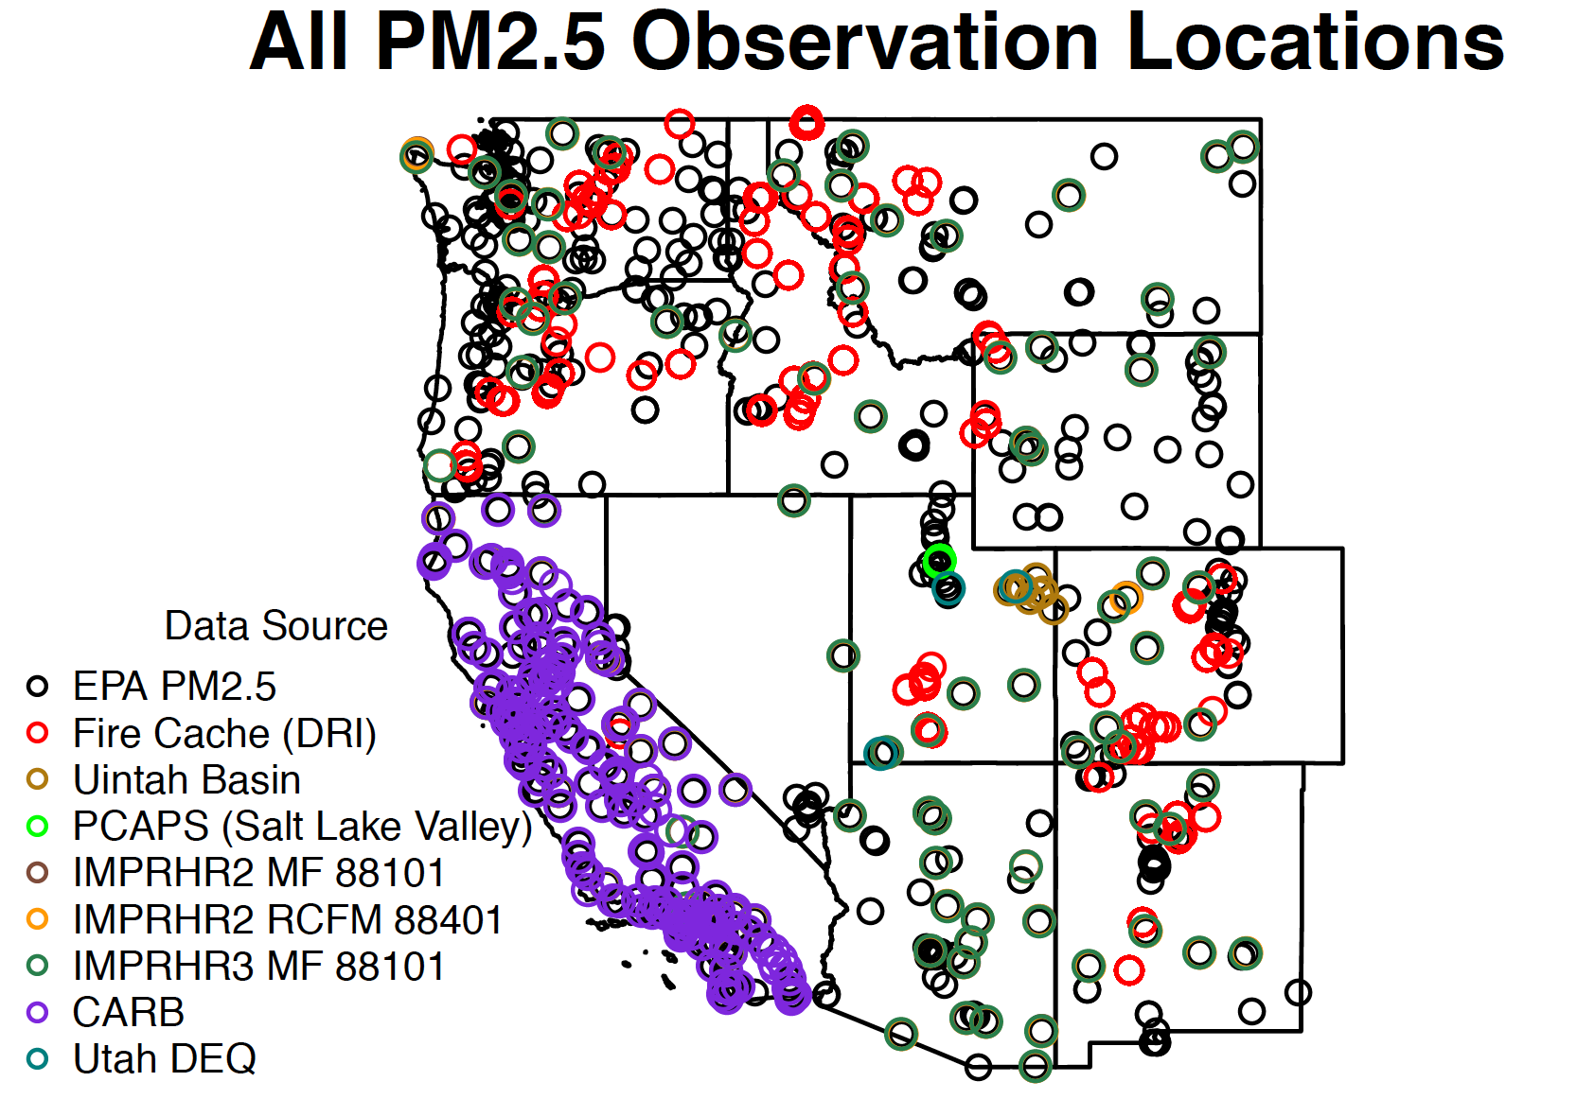
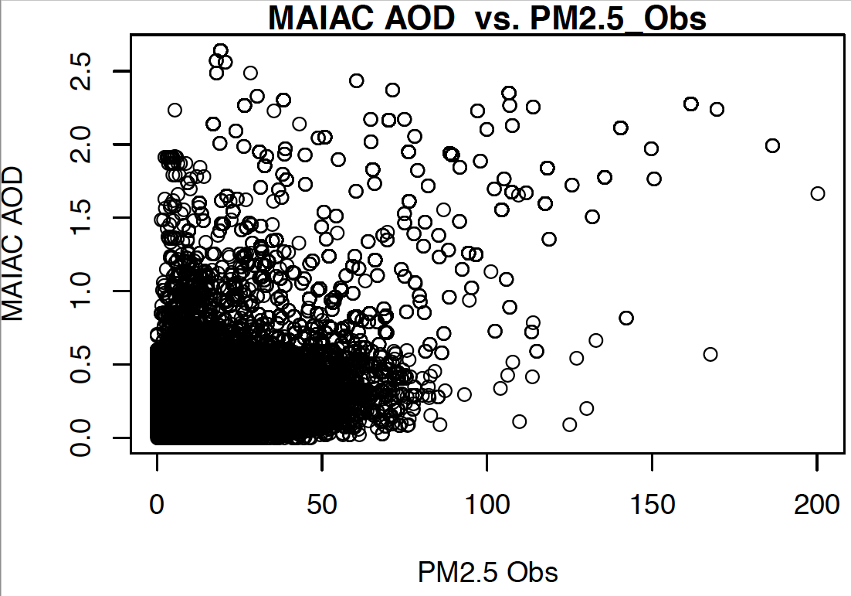
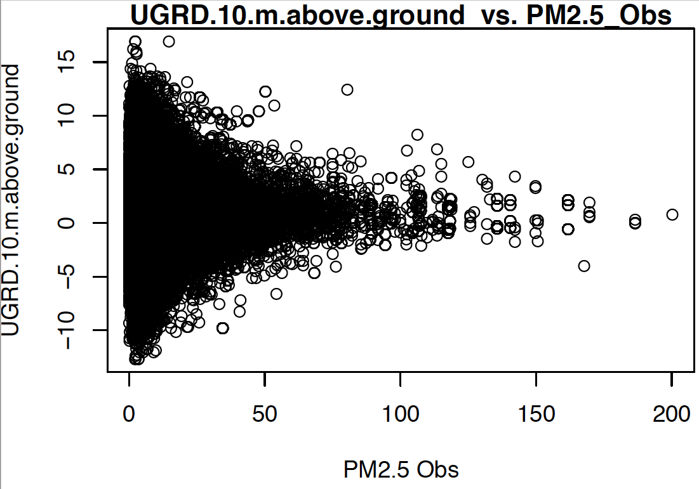
Machine learning for spatiotemporal PM_{2.5}
estimates across the western US, 2008-2014 Melissa May Maestas, Ph.D.
Why Wildfires?
Globally and regionally, wildfire risk is projected to increase under various potential future climate scenarios.
The percent of our air pollution due to wildfires will likely increase, not just from climatic changes, but also because of declines in other sources of air pollution
2008 CA Wildfires
Lightning storm on June 20-21, 2008
Over 6000 lightning strikes
Thousands of fires
Smoke covered large population areas for weeks (est. 10-12 million people exposed)
Potential for adverse health effects on large population
PM2.5 Observations July 11, 2008
PM2.5 Predictions July 11, 2008
Very Preliminary
ML Predictors
Variables | Data Source | Temporal Resolution | Spatial Resolution | Buffer Size
Dependent Variable
PM2.5 from monitoring stations | US EPA, states Federal Land Manager Environmental Database, Fire Cache Smoke Monitor Archive, IMPROVE Network, academic research groups | Daily or hourly | point
Spatiotemporal Variables
GOES Aerosol and Smoke Product (GASP) AOD | NOAA | Hourly | 4 km
Multi-Angle Implementation of Atmospheric Correction (MAIAC) AOD | NASA | Daily | 1 km
MODIS Active Fire Detection | NASA | Daily | 1 km
VIIRS Fire Occurence | NASA | Daily | 375 m
Hazard Mapping System (HMS) Smoke and Fire Product | NOAA | Daily | 4km | 25km, 50, 100km, 500km, 1000km, 2000km
MODIS Normalized Difference Vegetation Index (NDVI) | NASA | Monthly | 1 km
14 Meteorological Variables | NOAA: North American Mesoscale (NAM) Forecast System | 6-Hourly | 12 km
Spatial Variables
Elevation (m) | USGS | Nominal 2-month cycle | 1 arc-second
Percentages of land cover types | National Land Cover Database 2011 | Every 5 years | 30 m | 1km
Kilometers of highway within buffer zones | National Highways Planning Network, US DOT |  |  | 100, 250, 500, and 1000 m
Temporal Variables
Julian Date |  | Daily
Weekend |  | Daily
Project Status
Assembling data
Starting to run ML models
Previous ML work
Dr. Colleen E. Reid modeled Northern CA 2008 wildfire season for her dissertation
Reid et al., Spatiotemporal Prediction of Fine Particulate Matter During the 2008 Northern California Wildfires Using Machine Learning. Environ. Sci. Technol. 2015, 49, 3887−3896
Current Project – Scaling up:
Multi-year, 11 western states
Similar modeling (e.g., Di et al., 2016) don’t perform well in western US and fires were left out
More than EPA monitors (Forest Service, TEOM, states, field campaigns, etc.)
Plan to do ensemble of different machine learning algorithms
Di et al. Environ. Sci. Technol. 2016, 50, 4712−4721
Next Steps
Finish data assimilation
ML modeling
Ensemble modeling
Random Forest, others
Cross validation by region/time instead of 10-fold
Model by Region:
Predictor relationships could be different
Pull in CTM model output
Connect ML estimates to medical data for epidemiological analysis
Flexible Geographic Resolution
County centroid
Population-weighted county centroid
ZIP code
Geo-coded address
Image: National Interagency Fire Center, Fox Fire East, Glacier 2000
Exposure assessment difficulties
Sparse air pollutant monitoring network
Many PM_{2.5} monitors only measure every sixth or third day
Leads to spatial and temporal averaging of exposure measurements
But, smoke plumes migrate quickly, changing exposures over smaller spatial and temporal scales
Methods: Adapt land use regression modeling with machine learning
Include novel spatiotemporal datasets
Apply machine learning methods to
Select from a long list of predictor variables
Select from a variety of statistical algorithms
10-fold cross validation
May do spatial/temporal
Minimize CV-RMSE
Caret package in R
Acknowledgements
Earth Lab Research Funding and Support
University of Colorado Boulder’s Grand Challenge Initiative
Contributors
This poster represents the work of the Project Health team at Earth Lab: Colleen E Reid, PhD; Gina Li, MA-candidate; Ellen Considine, BS-candidate

